Slide 1

Wine Quality Detector
by -
E23CSEU0468 PRASANT MAAN
E23CSEU0460 JYOTISHMOY HAZARIKA
This presentation explores the development and application of an AI-powered wine quality detector, highlighting its potential to revolutionize the wine industry.

Slide 2
Introduction to the Wine Industry
A Global Industry
Growing Demand
The wine industry is a multi-billion dollar global market with a rich history and diverse production practices. The wine industry is composed of vineyards, wineries, and distributors who create, produce, and distribute wine worldwide.
Consumer demand for high-quality wines is increasing, leading to a growing need for reliable and efficient quality assessment methods.

Slide 3

Challenges in Wine Quality Assessment
1
Subjectivity
2
Consistency
Wine quality is often subjective, relying on sensory evaluation by trained professionals.
Ensuring consistent quality across production batches can be challenging due to varying grape maturity and environmental factors.
3
Time-Consuming
Traditional sensory analysis methods are time-consuming and labor-intensive, delaying market entry.

Slide 4
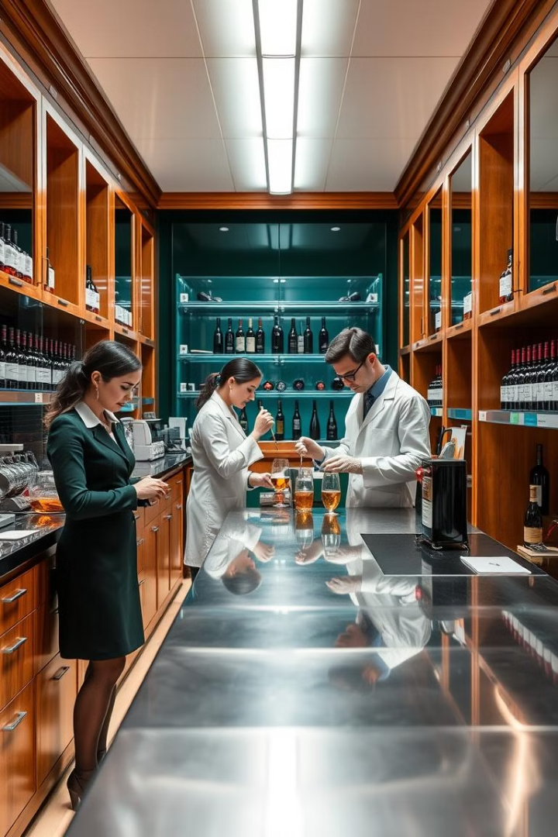
Limitations of Traditional Methods
Chemical Analysis
Sensory Evaluation
Traditional methods often rely on chemical analysis, which can be expensive and time-consuming.
Sensory evaluation relies on human experts, introducing subjectivity and potential biases.
Limited Scope
These methods often focus on specific factors and may not capture the complexity of wine quality.

Slide 5




The Role of Artificial Intelligence
Data Analysis
AI can analyze vast datasets of chemical, sensory, and production data to identify patterns and correlations.
Automated Assessment
AI models can automate quality assessment tasks, eliminating the need for human intervention.
Predictive Models
AI can predict wine quality with high accuracy based on various factors, including grape variety, climate, and production techniques.

Slide 6
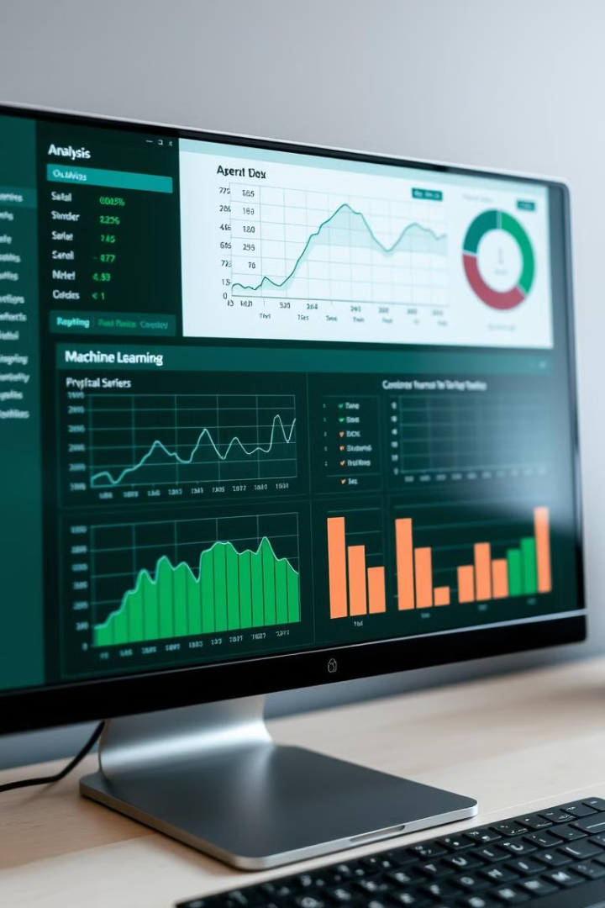
Our AI-based Wine Quality Detector
1
Our model is trained on a dataset of wine characteristics, including chemical analysis, sensory evaluation, and production information.
2
The model utilizes advanced machine learning algorithms to identify patterns and correlations between wine attributes and quality.
3
The AI model can then predict the quality of a wine sample based on its unique characteristics, providing insights into its potential market value.

Slide 7




Key Features and Capabilities
Real-time Analysis
Predictive Accuracy
Personalized Recommendations
The AI model can provide real-time feedback on wine quality, enabling faster decision-making in production and distribution.
The model demonstrates high accuracy in predicting wine quality, exceeding traditional methods in certain cases.
The AI can provide personalized recommendations for wine pairings, improving the consumer experience and driving sales.

Slide 8



Validation and Testing Results
Independent Validation
1
The AI model was validated using a separate dataset of wines with known quality scores.
Comparative Analysis
2
The results were compared to traditional methods, demonstrating the AI model's superior performance.
High Accuracy
3
The AI model consistently achieved high accuracy rates in predicting wine quality.

Slide 9
Benefits and Applications
Quality Control
1
The AI-based wine quality detector can be integrated into wine production lines to ensure consistent quality.
Market Insights
2
The model provides valuable insights into consumer preferences, allowing winemakers to tailor their products accordingly.
Improved Consumer Experience
3
Personalized recommendations based on AI analysis can enhance the consumer experience and drive sales.

Slide 10

Conclusion and Future Developments
1
2
Revolutionizing the Industry
Continued Innovation
We are actively exploring new features and applications for the AI model, such as virtual wine tasting experiences.
Our AI-powered wine quality detector represents a significant step towards revolutionizing the wine industry.

